Slide 1

University Management system OOTs Using JAVA (BCSEH0352)
Department of Computer Science and Engineering
CSE-R
(Submitted To: Ms. Aditee Mattoo)
Group Members
Name of Member | Roll Number | Role | Department n Section
Abhishek Kumar Pandey | 2301331690005 | Back end Design and GUI | CSE-R
Ishan Arya | 2301331690017 | Documentation , Front End Design | CSE-R
Naveen Kumar | 2301331690025 | Database | CSE-R

Slide 2

University Management System in Java
A Java-based University Management Program

Slide 3
Introduction
This project involves the development of a University Management System using basic Java.
The goal is to automate and streamline the management of student and faculty records, course enrollments, grades, and other administrative tasks in a university environment.

Slide 4
Literature Survey / Existing System
Currently, many universities use manual or semi-automated systems for managing academic processes.
Some universities have ERP systems in place, but these are often expensive and complex.
This project aims to develop a more accessible solution using basic Java, focusing on simplicity and efficiency.

Slide 5
Problem Statement & Proposed Methodology
Problem Statement: Universities often struggle to manage large amounts of student, faculty, and course data effectively.
Proposed Methodology: Develop a basic Java application that allows administrators to manage data in a structured way.
This will include creating modules for student registration, course enrollment, faculty records, and grades, using Java's object-oriented programming (OOP) principles.

Slide 6
Feasibility Study & Hardware/Software Requirements
Feasibility Study: The project is feasible using basic Java, especially focusing on file handling and OOP concepts for data management.
Hardware Requirements: Any basic computer system.
Software Requirements: JDK, an IDE (e.g., Eclipse or IntelliJ IDEA), and basic text editors for code editing.

Slide 7
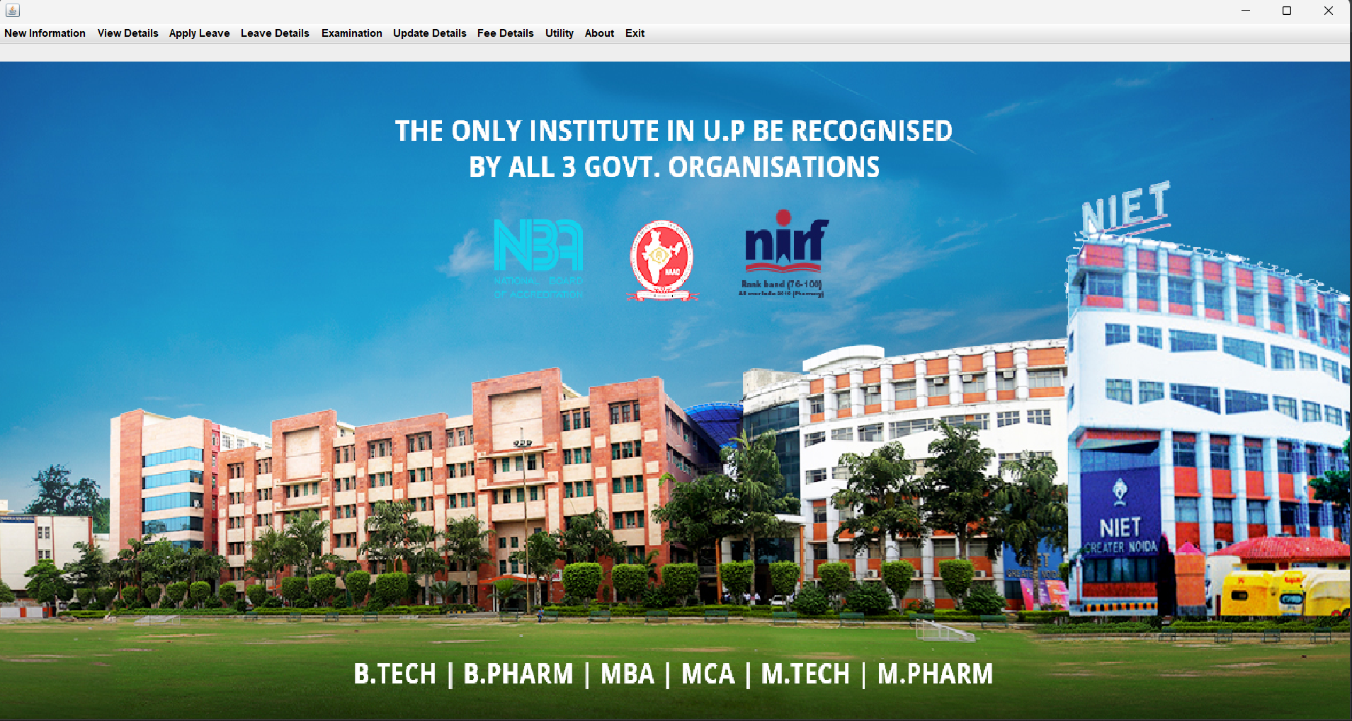
Results and Conclusion
The system successfully manages university operations such as student enrollment, course assignments, and grade tracking.
This project demonstrates that even with basic Java knowledge, a functional and scalable system can be developed to address real-world problems.

Slide 8
References & Live Demonstration
References:
Java: The Complete Reference by Herbert Schildt
Various Java documentation and online resources by TechCoder A.V
Live Demonstration: A working demonstration of the project is available, showcasing how the system manages data efficiently.

